Slide 1

MICRON – HF WASTEWATER TREAMENT
SIMULATION & BENCH TESTING – Dec 2021
Siva Kumar Kota/Chun Yew
Hiep Le/Sankar

Slide 2
HFW Treatment Objectives
The objectives of simulation and bench testing are
To identify the optimized flow scheme to treat HFW wastewater
To compare the treatability of the HFW wastewater between Calcium hydroxide and Calcium chloride.
To compare the quantity and quality of generated sludge
To meet sludge quality >80% of CaF2
To meet discharge F<10ppm and TDS <3000 ppm

Slide 3
Simulation summary
Option 1 – NF90/270 + BWRO
Option 1a – NF270 + BWRO (Two Pass)
Option 2 – NF270 + SWRO (Single Pass)
Option 3– NF270 + SWRO (1st pass) + BWRO (2nd pass)
Option 4– NF270 + SWRO (1st stage) + BWRO (2nd stage)
Option 5– NF270 followed by SWRO (clarified water recycle)
Option 5a– NF270 followed by SWRO (separate sludge)
Option 6– NF270 followed by SWRO (F-800 ppm)
Option 6a– NF270 followed by SWRO (F-800 ppm and combined sludge)
Option 6b– NF270 followed by SWRO (F-600 ppm)
Option 7- HFW Effluent treatment
Notes:
600 ppm max
350 ppm avg

Slide 4
Micron 10X – Influent Wastewater quality
Parameters | Unit | HF Wastewater
TDS | mg/L | 698
pH | - | 3.6
TSS | mg/L | 96.0
NH₄ | mg/L | 207
HCO₃ | As CaCO3 mg/L | <20
CO₃ | As CaCO3 mg/L | <20
NO₃ | mg/L | 73.4
SO₄ | mg/L | 174
K | mg/L | 2.92
Na | mg/L | 250
Mg | mg/L | 0.085
Ca | mg/L | 0.20
Sr | mg/L | 0.00041
Ba | mg/L | 0.0016
Cl | mg/L | 25.1
Parameters | Unit | HF Wastewater
F | mg/L | 1136
SiO2 | mg/L | 50.8
B | mg/L | 0.25
Al | mg/L | 0.068
Br | mg/L | 30.3
Cu | mg/L | 0.0028
Fe | mg/L | 0.065
Mn | mg/L | 0.0058
TOC | mg/L | 75.8
O&G | mg/L | <10
PO4 | mg/L | 12.3
COD | mg/L | 280
Total Hardness | As CaCO3 mg/L | 0.85
Total Alkalinity | As CaCO3 mg/L | <20

Slide 5
^{Option1 - NF90/270 + BWRO}
reject
F: 150 m3/hr
F:1136 mg/l
PO4: 100 mg/l
NF
F: 105 m3/hr
F:404 mg/l
PO4: 0 mg/l
BWRO
F: 90 m3/hr
F:30 mg/l
PO4: 0 mg/l
F: 85 m3/hr
F:<10 mg/l
PO4: 0 mg/l
Polishing Filters
UF
HF WW
Treated Water
F: 61 m3/hr
F:3957 mg/l
PO4: 355,2 mg/l
Coagulation, Clarifier
sludge
5
Notes:
NF/RO –projections
FBR –Reject treatment
Npv calculations

Slide 6
Simulation summary
Performed different simulations/projections for the scheme UF, NF & RO scheme
UF:
WW contains high amount of TSS (96 mg/l) and TOC (>50 mg/l).
Achieved recovery ~84% at 41 LMH
NF & RO:
Tried different types of membranes (tighter vs loose membrane)
WW contains high amount of F (1136 mg/l) and Phosphate (100 mg/l).
Tighter membrane:
Phosphate rejection>99.5%
Fluoride rejection~70%
Loose membrane:
Phosphate rejection>99.5%
Fluoride rejection : 30-40%
Overall system recovery ~72%
6
Notes:
NF/RO –projections
FBR –Reject treatment
Npv calculations

Slide 7
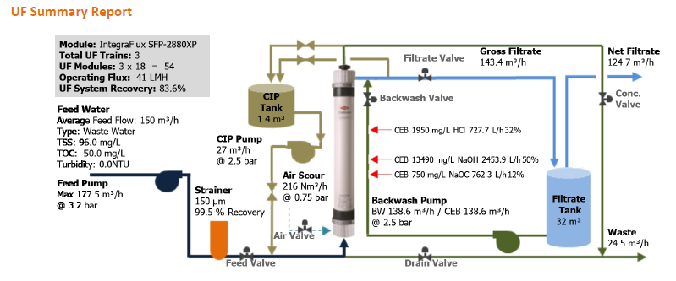
UF Projections
NF
RO

Slide 8
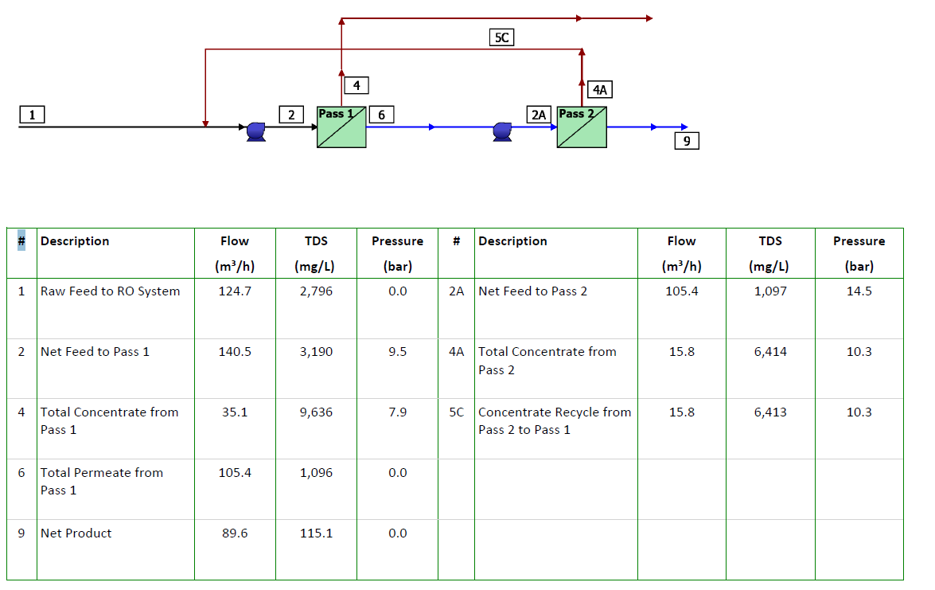
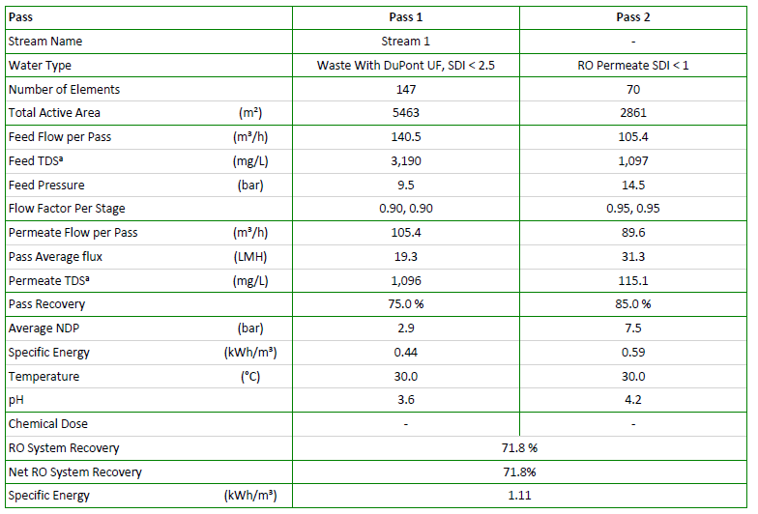
NF & RO Projections
NF
RO

Slide 9
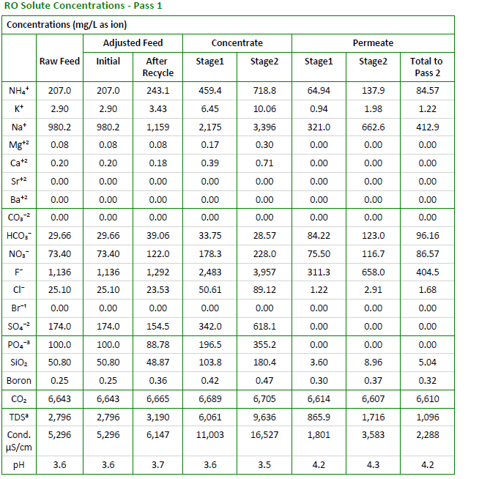
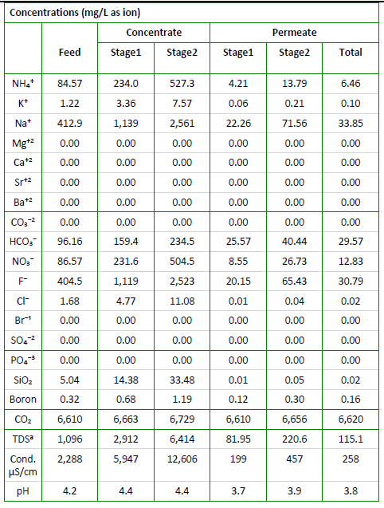
NF & RO Projections Contd.,
NF – Tighter membrane
BWRO

Slide 10
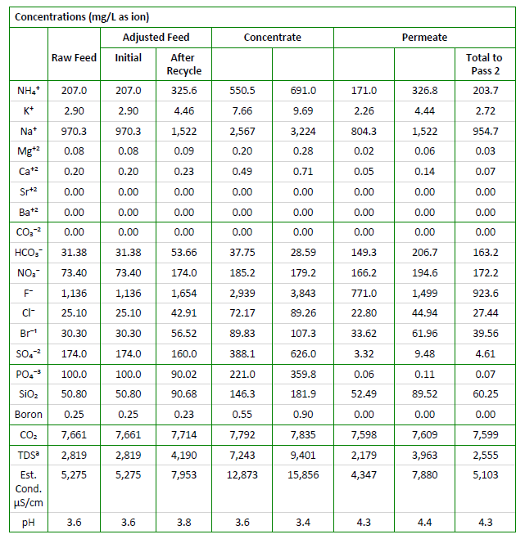
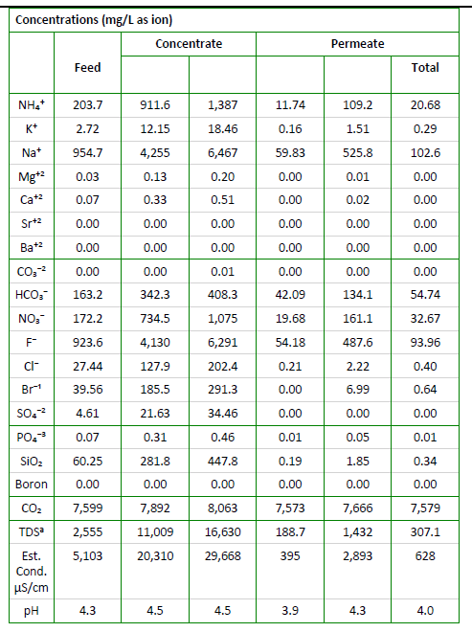
NF & RO Projections Contd.,
NF – Loose membrane
BWRO

Slide 11
Option1a - NF270 + BWRO (Two Pass)
reject
F: 150 m3/hr
F:1136 mg/l
PO4: 100 mg/l
NF270
BWRO (2 pass)
Polishing Filters
Treated Water
UF
HF WW
Coagulation, Clarifier
sludge
11
Notes:
NF/RO –projections
FBR –Reject treatment
Npv calculations
SWRO – 1 PASS
BWRO -2 PASS
SWRO + BWRO
Treated water BWRO

Slide 12
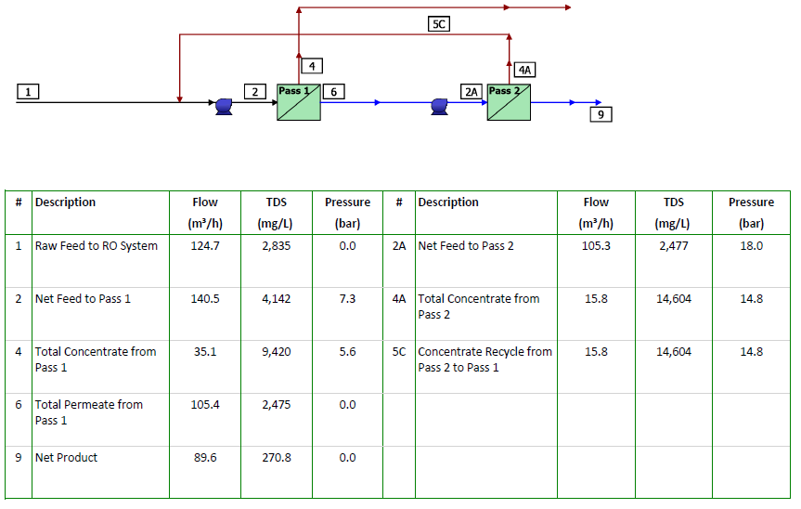
Option 1a – NF270 + BWRO (TWO Pass)

Slide 13
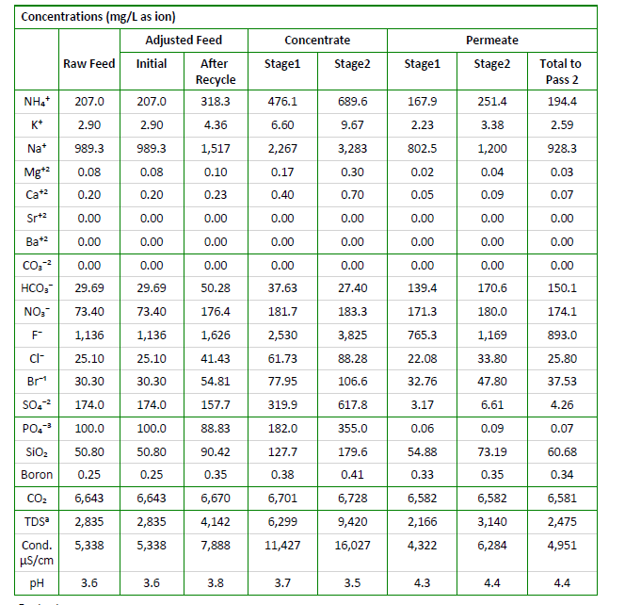
Option 1a – NF270 + BWRO (TWO Pass)
NF 270– Loose membrane

Slide 14
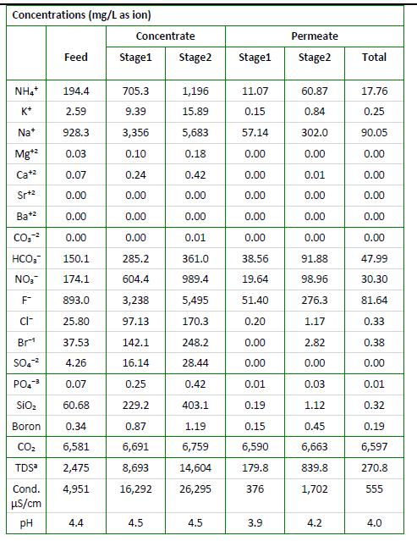
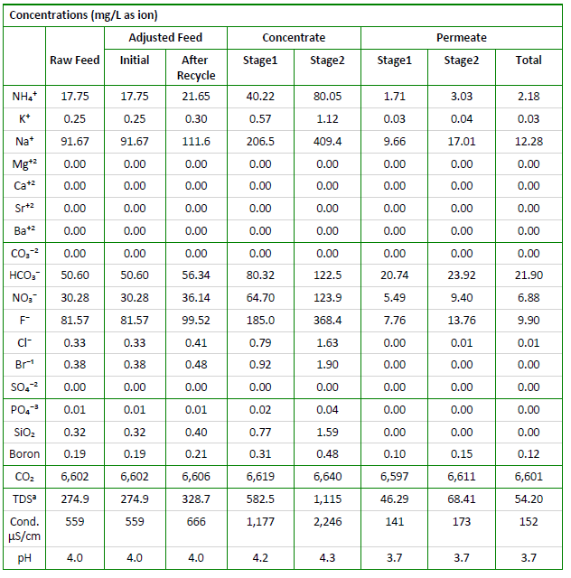
Option 1a – NF270 + BWRO (TWO Pass)
1st Pass BWRO
2nd Pass BWRO

Slide 15
^{Option 2 -} ^{NF270 + SWRO (SINGLE Pass)}
F: 150 m3/hr
F:1136 mg/l
PO4: 100 mg/l
NF270
SWRO
Polishing Filters
Treated Water
UF
HF WW
Coagulation, Clarifier
Coagulation, Clarifier
CaF2 sludge
Phosphate sludge
15
Notes:
NF/RO –projections
FBR –Reject treatment
Npv calculations

Slide 16
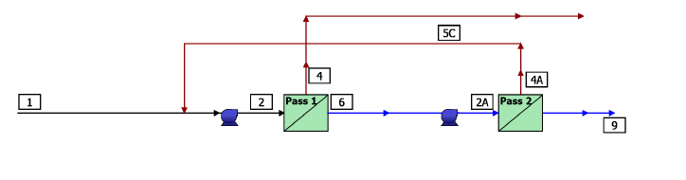
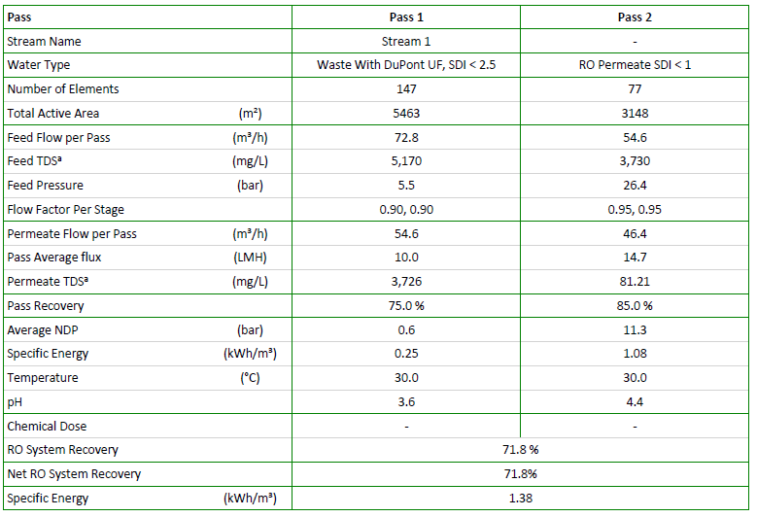
Option 2 – NF270 + SWRO (SINGLE Pass)

Slide 17
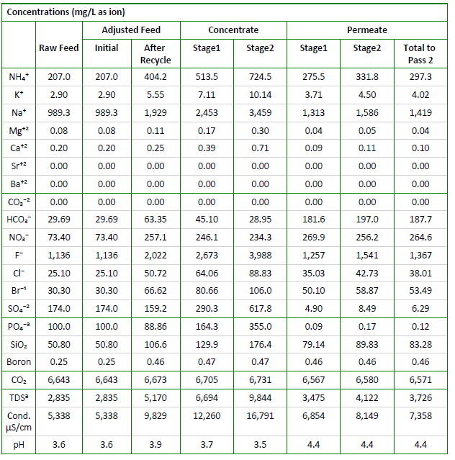
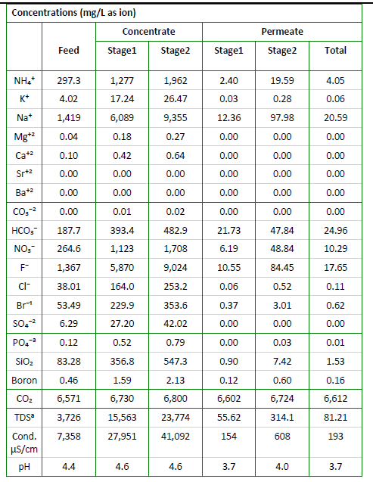
Option 2 – NF270 + SWRO (SINGLE Pass)
NF270
SWRO

Slide 18
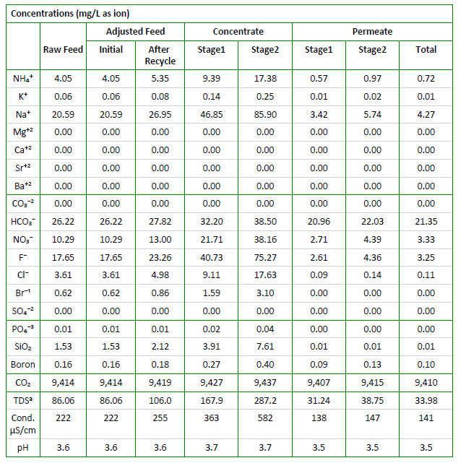
Option 3– NF270 + SWRO (1st pass) + BWRO (2nd pass)
BWRO (2nd pass)
NEWater
Chemical Parameters
Ammonia (as N) | mg/L | <1.0
Aluminium | mg/L | <0.1
Barium | mg/L | <0.1
Boron | mg/L | <0.5
Calcium | mg/L | <20
Chloride | mg/L | <20
Copper | mg/L | <0.05
Fluoride | mg/L | <0.5
Iron | mg/L | <0.04
Manganese | mg/L | <0.05
Nitrate (as N) | mg/L | <5
Sodium | mg/L | <20
Sulphate | mg/L | <5
^{Silica (as SiO}₂⁾ | mg/L | <3
Strontium | mg/L | <0.1
Total Trihalomethanes Ratio | - | <0.04
Total Organic Carbon (TOC) | mg/L | <0.5
^{Total Hardness (as CaCO}₃⁾ | mg/L | <50
Zinc | mg/L | <0.1

Slide 19
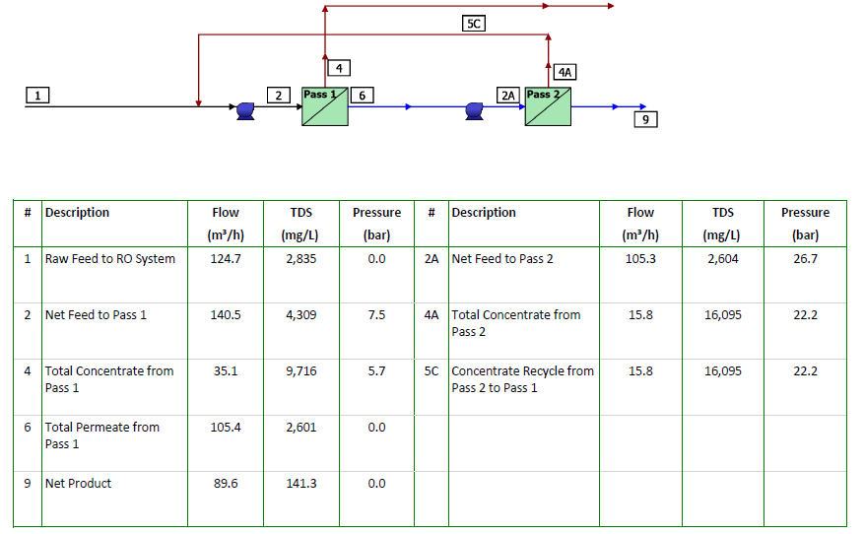
Option 4– NF270 + SWRO (1st stage) + BWRO (2nd stage)

Slide 20
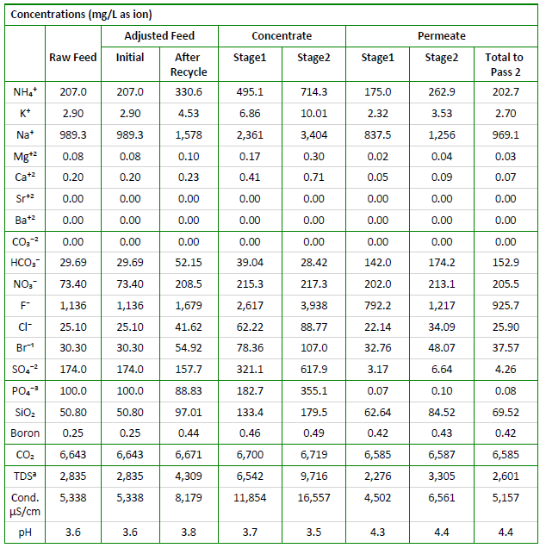
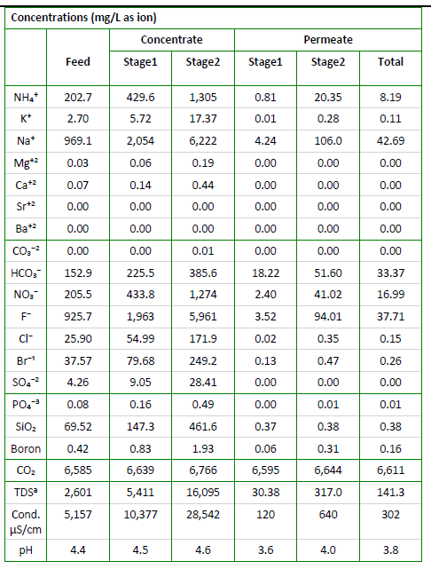
Option 4– NF270 + SWRO (1st stage) + BWRO (2nd stage)
NF270
SWRO (1st stage) + BWRO (2nd stage)

Slide 21
Option 5 -NF270 followed by SWRO (clarified water recycle)
F: 150 m3/hr
F:1136 mg/l
PO4: 100 mg/l
NF 270
SWRO
Polishing Filters
Treated Water
UF
HF WW
Coagulation, Clarifier
Coagulation, Clarifier
CaF2 sludge
Phosphate sludge
21
Notes:
NF/RO –projections
FBR –Reject treatment
Npv calculations

Slide 22
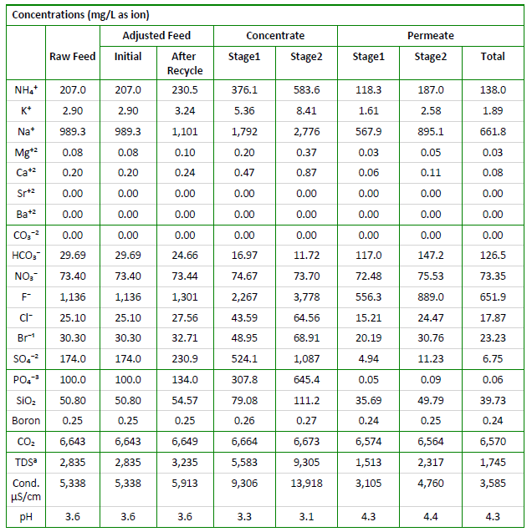
Option 5– NF270 followed by SWRO
NF270

Slide 23
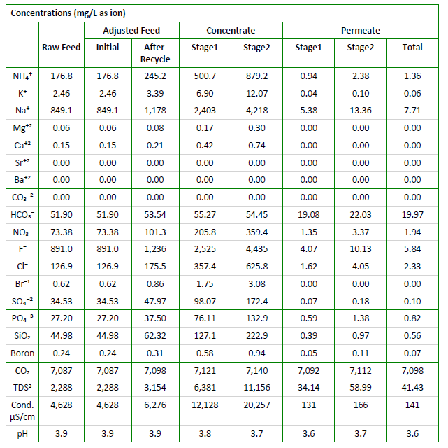
Option 5– SWRO (NF permeate and F rich clarified water)
SWRO

Slide 24
^{Option 5a -} NF270 followed by SWRO (separate sludge)
F: 150 m3/hr
F:1136 mg/l
PO4: 100 mg/l
NF270
SWRO
Polishing Filters
Treated Water
UF
HF WW
Coagulation, Clarifier
Coagulation, Clarifier
CaF2 sludge
Phosphate sludge
24
Notes:
NF/RO –projections
FBR –Reject treatment
Npv calculations
Ammonia -20 ppm
TOC-<5
FLUORIDE -800 PPM

Slide 25
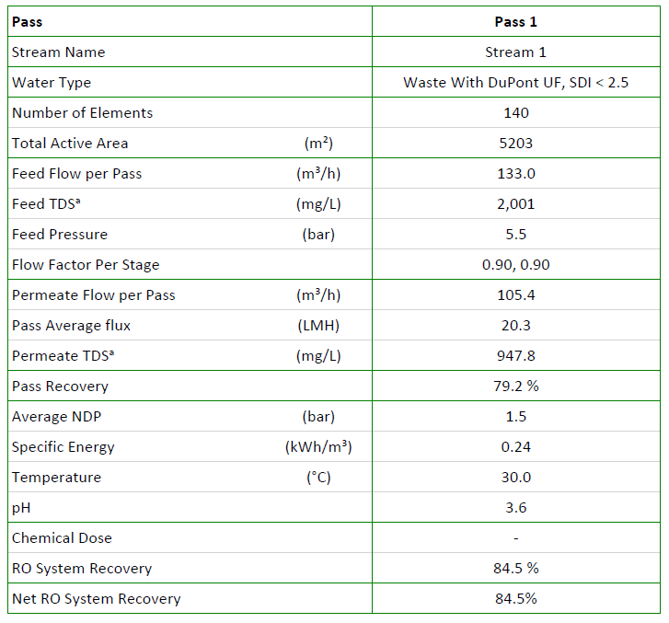
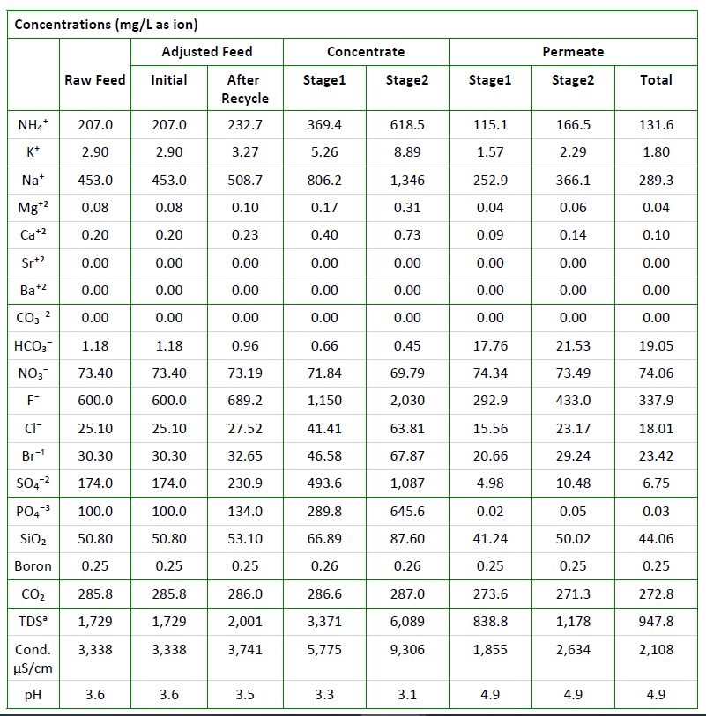
Option 5a – NF270 (Loose membrane)

Slide 26
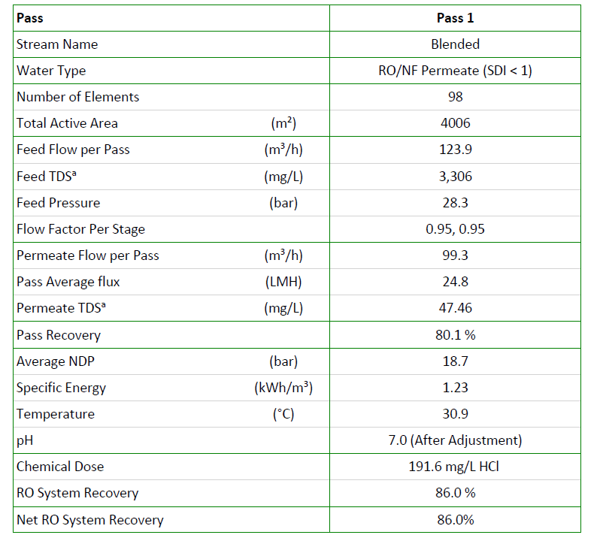
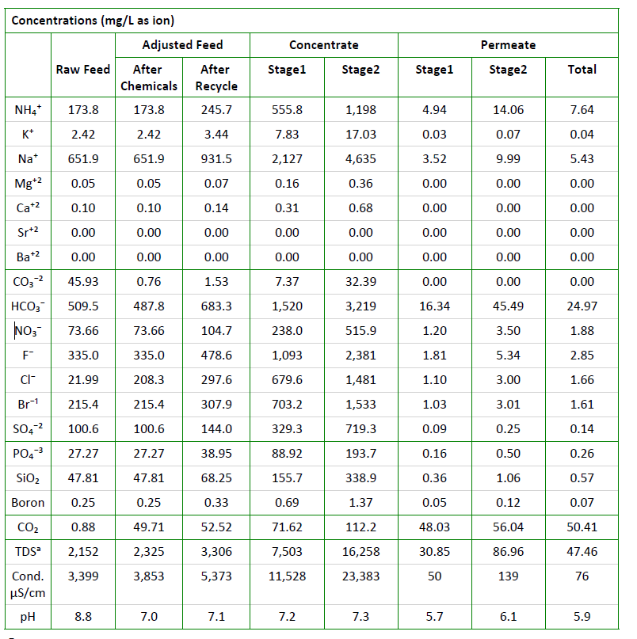
Option 5a – SWRO with pH adjustment

Slide 27
NEWater spec
Chemical Parameters
Ammonia (as N) | mg/L | <1.0
Aluminium | mg/L | <0.1
Barium | mg/L | <0.1
Boron | mg/L | <0.5
Calcium | mg/L | <20
Chloride | mg/L | <20
Copper | mg/L | <0.05
Fluoride | mg/L | <0.5
Iron | mg/L | <0.04
Manganese | mg/L | <0.05
Nitrate (as N) | mg/L | <5
Sodium | mg/L | <20
Sulphate | mg/L | <5
^{Silica (as SiO}₂⁾ | mg/L | <3
Strontium | mg/L | <0.1
Total Trihalomethanes Ratio | - | <0.04
Total Organic Carbon (TOC) | mg/L | <0.5
^{Total Hardness (as CaCO}₃⁾ | mg/L | <50
Zinc | mg/L | <0.1

Slide 28
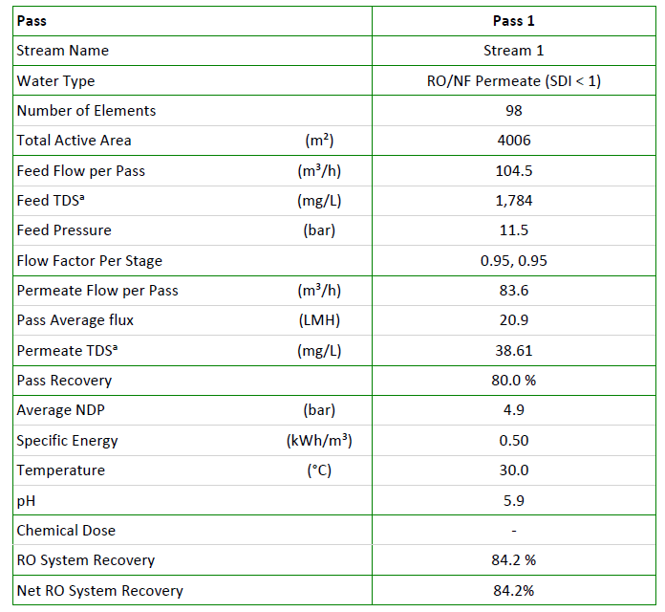
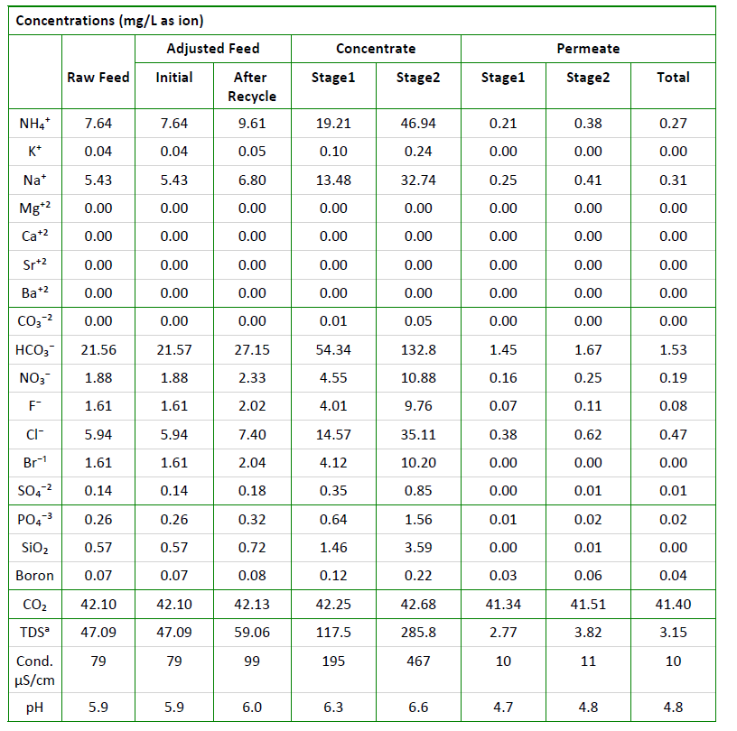
Option 5a – polishing BWRO to meet NEWater
Notes:
Cooling water spec
Ammonia<5ppm
Fluoride<2 ppm

Slide 29
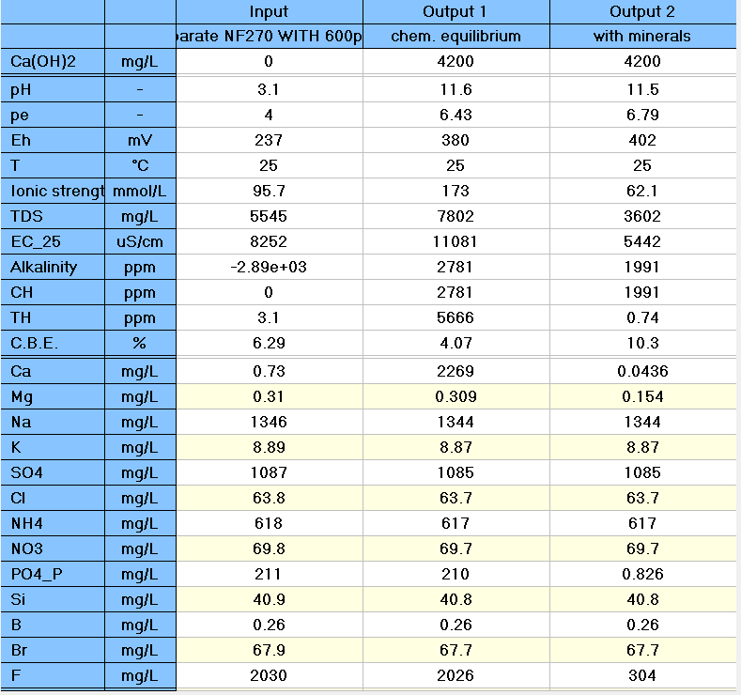
Option 5a - NF270 Reject chemical precipitation using Ca(OH)2

Slide 30
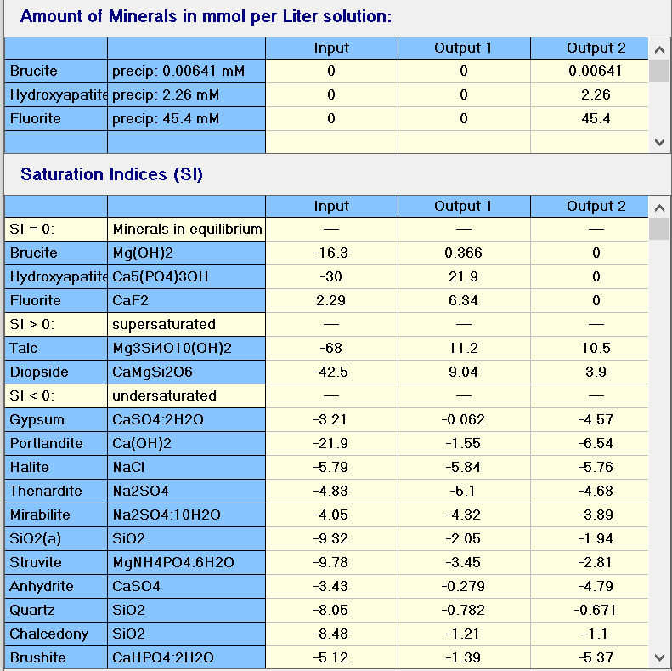
Option 5a- NF270 Reject chemical precipitation using Ca(OH)2

Slide 31
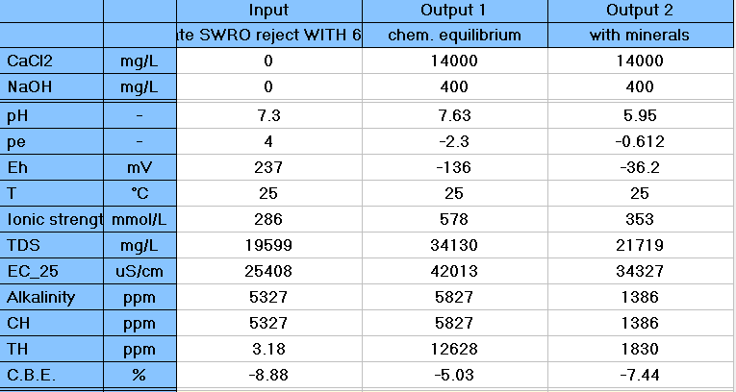
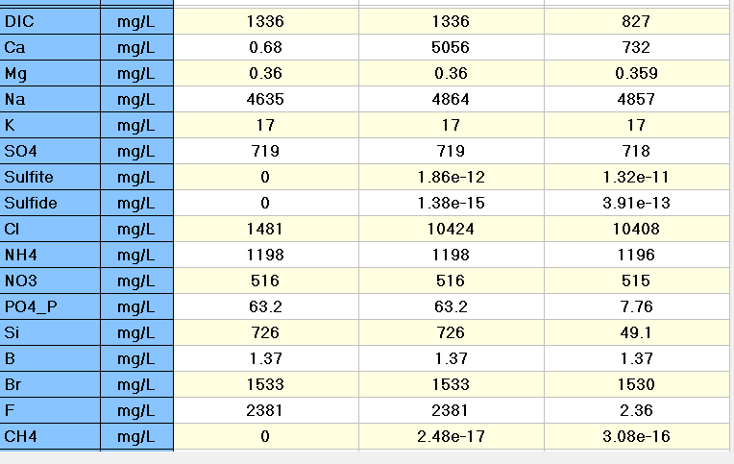
Option 5a-SWRO Reject chemical precipitation

Slide 32
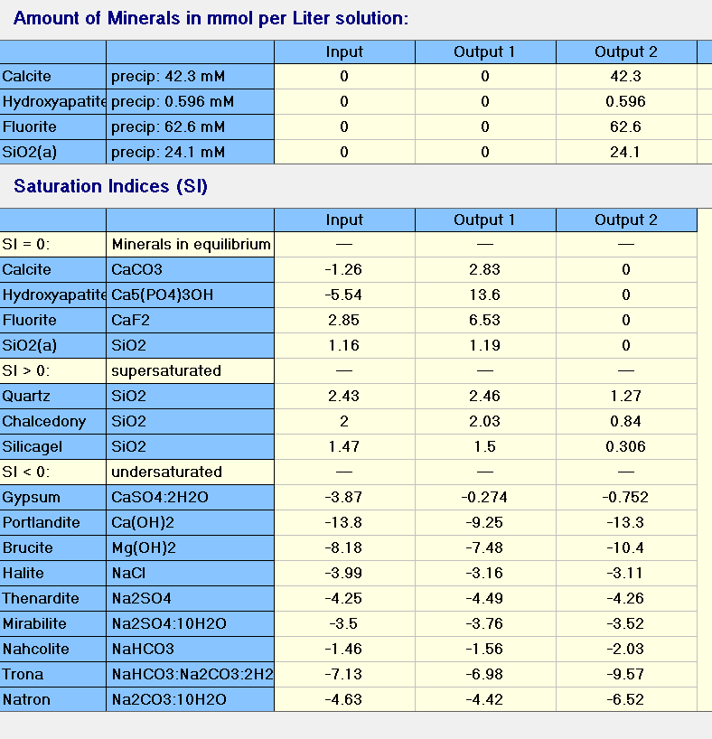
Option 5a -SWRO Reject chemical precipitation

Slide 33
^{Option 6 -} NF270 followed by SWRO (F-800 ppm)
F: 150 m3/hr
F:800 mg/l
PO4: 100 mg/l
UF
NF270
Stream 8
SWRO
BWRO (optional)
HF WW
Stream 2
Stream 3
Stream 7
Stream 1
Stream 4
Stream 9
CoagulationClarifier
Coagulation,Clarifier
Sludge
Sludge
Stream 11
Stream 6
Stream 10
Stream 5
Polishing filters
Stream 12
33
Notes:
NF/RO –projections
FBR –Reject treatment
Npv calculations
Ammonia -20 ppm
TOC-<5
FLUORIDE -800 PPM
AMMONIUM PEROXIDE WASTE- H2O2
PETERG7@

Slide 34
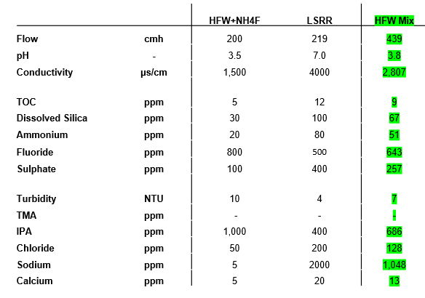
HFW – Feed Water Characteristics

Slide 35
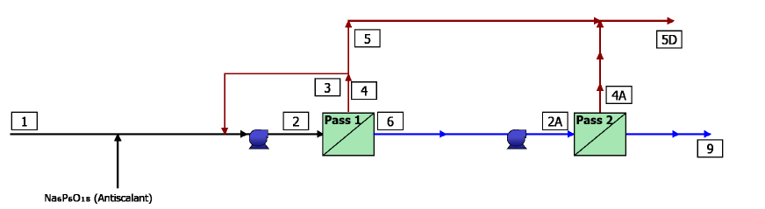
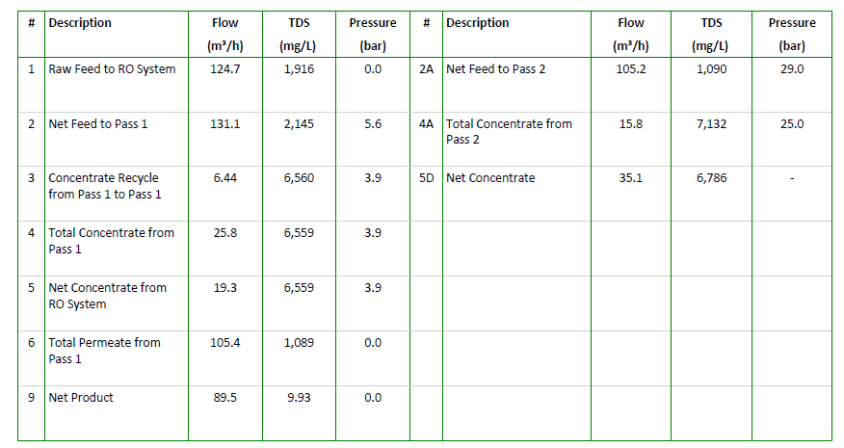
Option 6 – NF270 + SWRO With 800 ppm of F

Slide 36
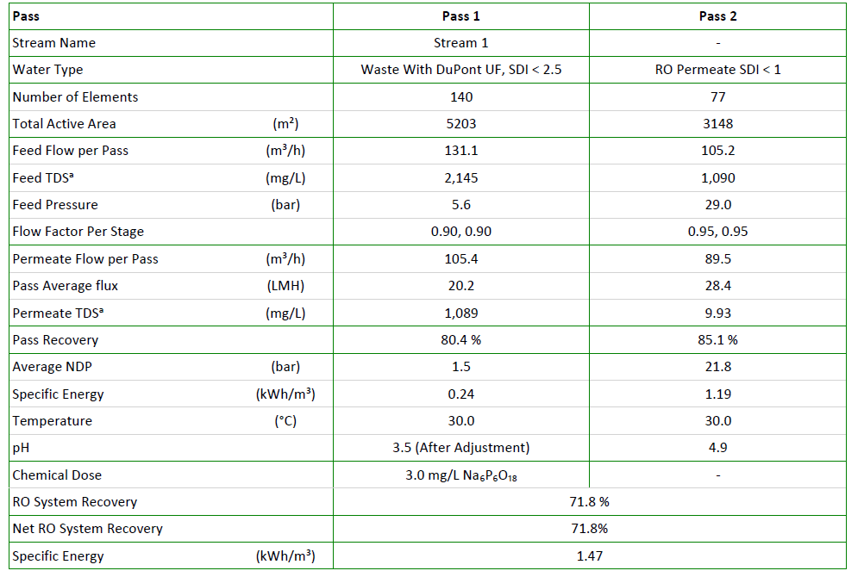
Option 6 – NF270 + SWRO With 800 ppm of F

Slide 37
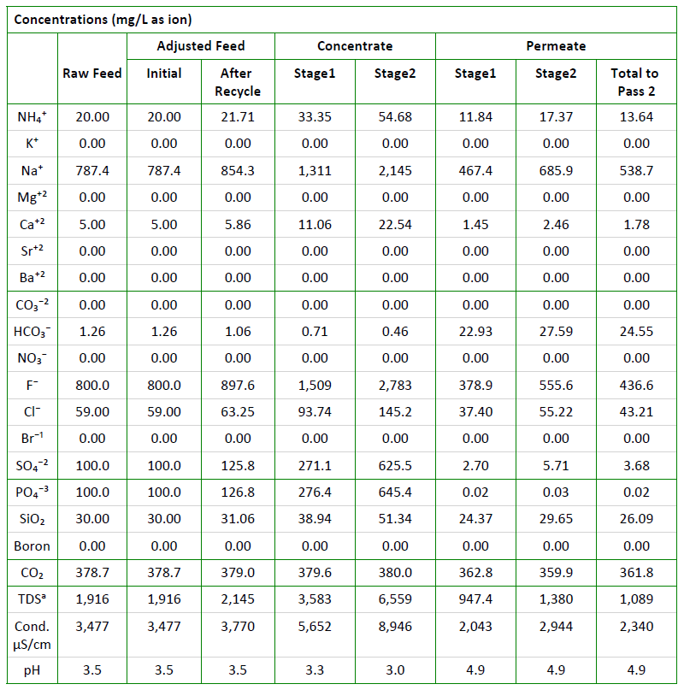
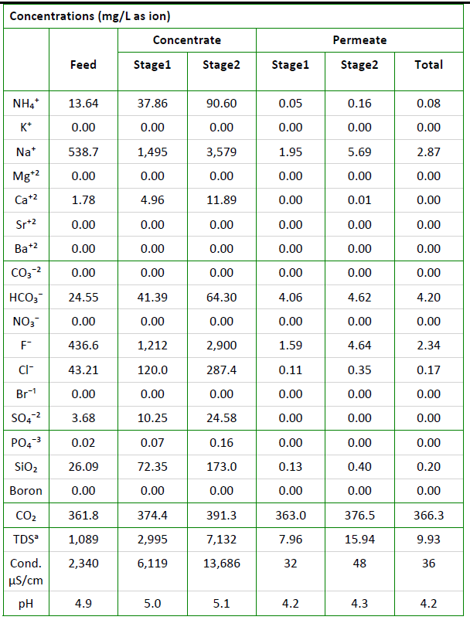
Option 6 – NF270+SWRO with 800 PPM of F
NF270
SWRO
Stream 4
Stream 9

Slide 38
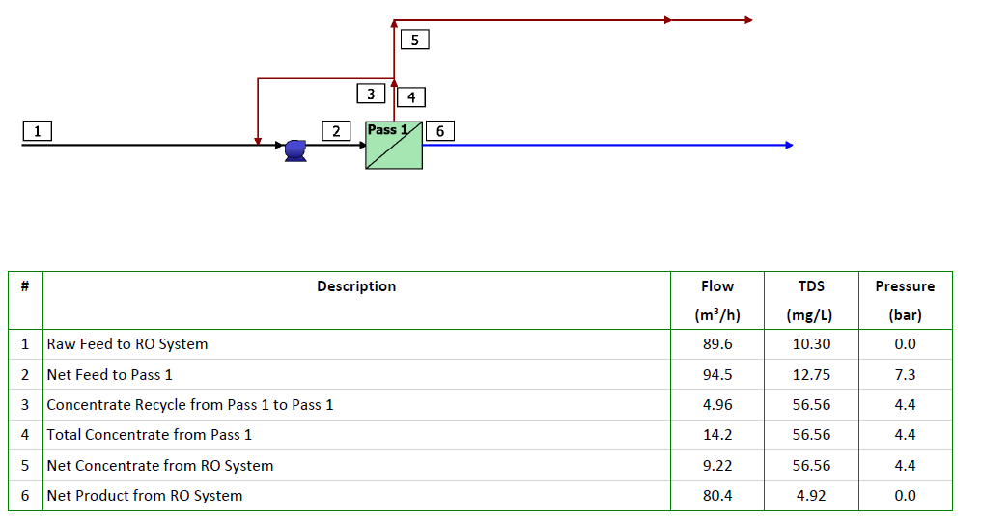
Option 6 – Polishing BWRO to meet NEWater
Notes:
Cooling water spec
Ammonia<5ppm
Fluoride<2 ppm

Slide 39
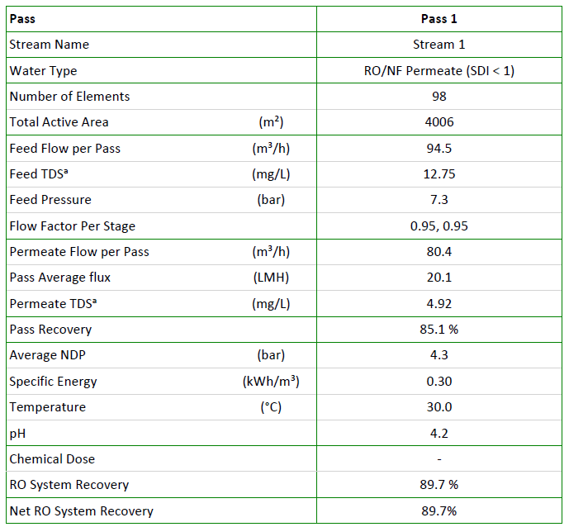
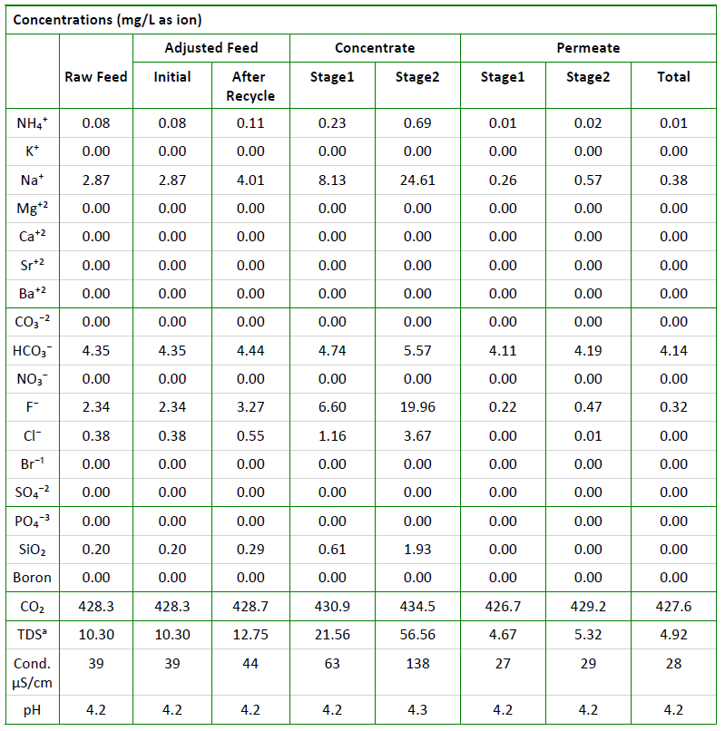
Option 6 – Polishing BWRO to meet NEWater
Notes:
Cooling water spec
Ammonia<5ppm
Fluoride<2 ppm

Slide 40
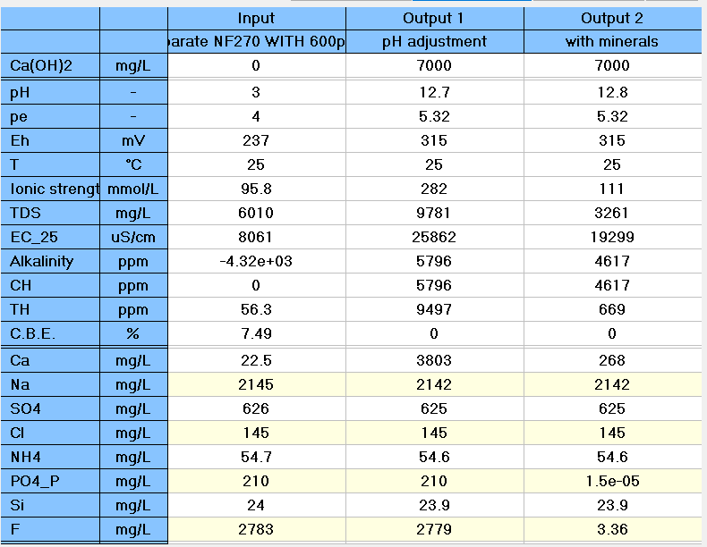
Option 6-NF270 Reject chemical precipitation using Ca(OH)2
Stream 4→19.3 m3/hr
Stream 6-sludge
Stream 5→18 m3/hr

Slide 41
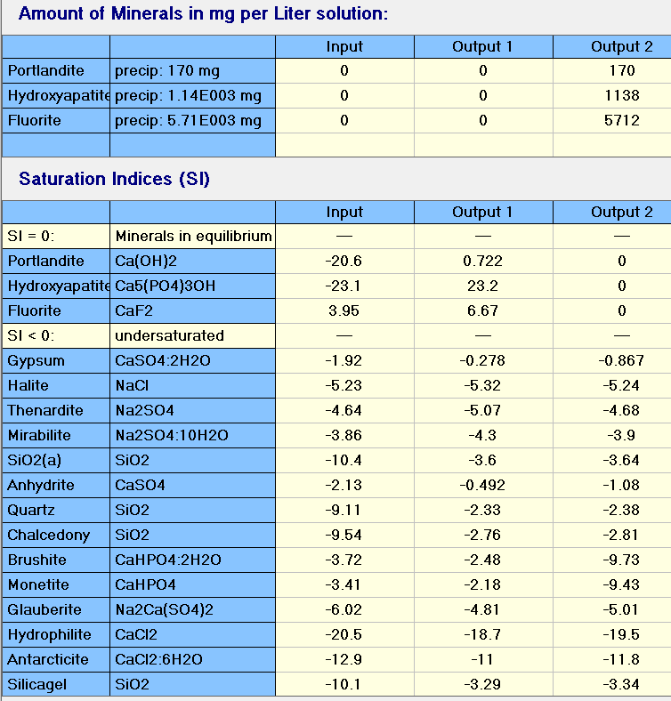
Option 6- NF270 Reject chemical precipitation using Ca(OH)2
>80% of CaF2 sludge

Slide 42

Option 6- SWRO Reject chemical precipitation
Stream 11-sludge
Stream 10→14.8 m3/hr
Stream 9→15.8 m3/hr

Slide 43
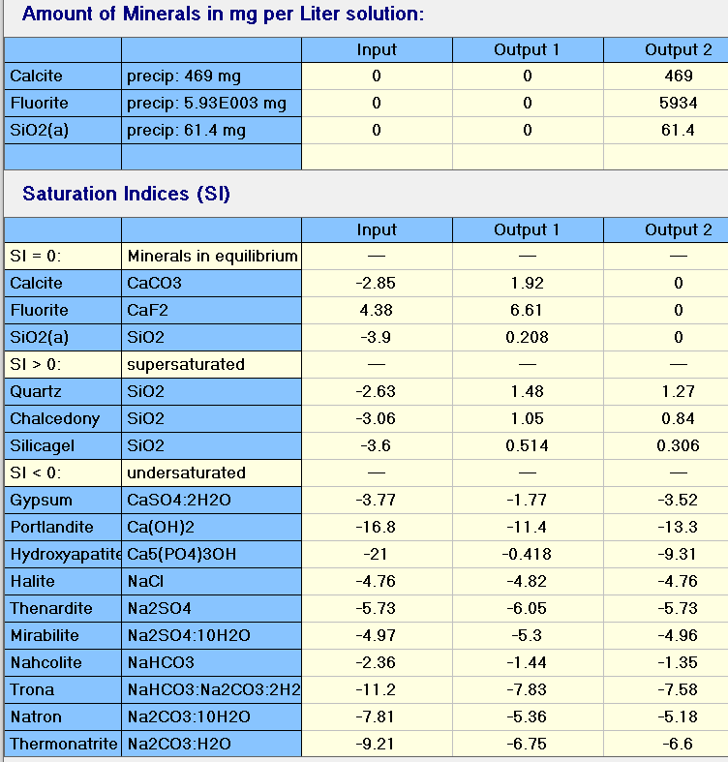
Option 6 -SWRO Reject chemical precipitation
>80% of CaF2 sludge

Slide 44
Option 6a – NF270 followed by SWRO (F-800 ppm and combined sludge)
F: 150 m3/hr
F:800 mg/l
PO4: 100 mg/l
UF
NF270
SWRO
BWRO (optional)
HF WW
Stream 2
Stream 3
Stream 9
Stream 1
Stream 10
Stream 4
Stream 5
CoagulationClarifier
Sludge
Stream 7
Stream 6
Polishing filters
Stream 8
44
Notes:
NF/RO –projections
FBR –Reject treatment
Npv calculations
Ammonia -20 ppm
TOC-<5
FLUORIDE -800 PPM

Slide 45

Option 6a–combined reject chemical precipitation –CaF2 sludge
Stream 7-sludge
Stream 6→33.5 m3/hr
Stream 4&5→35.3 m3/hr

Slide 46
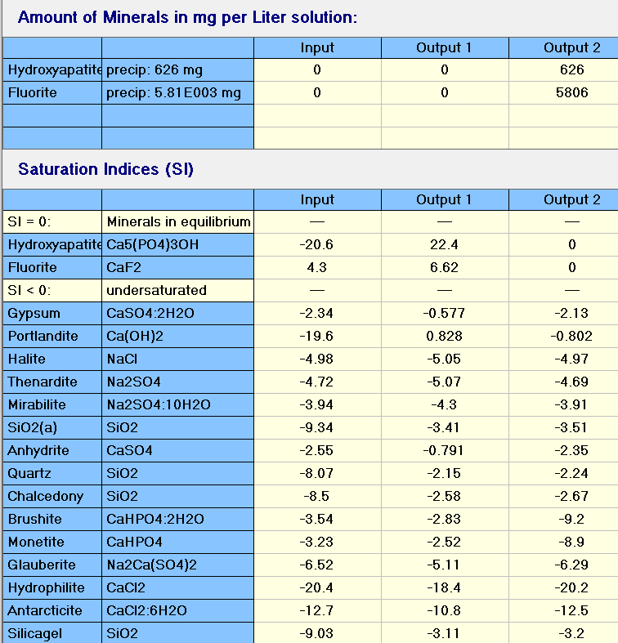
Option 6a–combined reject chemical precipitation –CaF2 sludge
>80% of CaF2 sludge

Slide 47
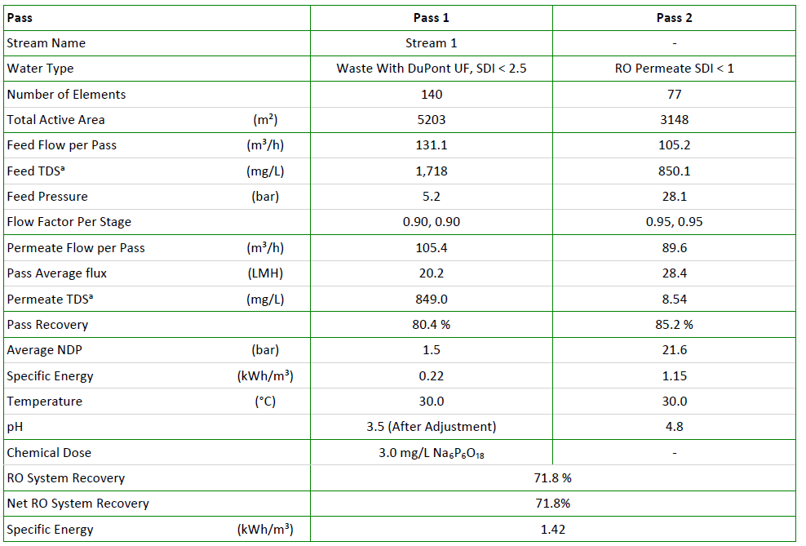
Option 6b – NF270 + SWRO With 600 ppm of F

Slide 48
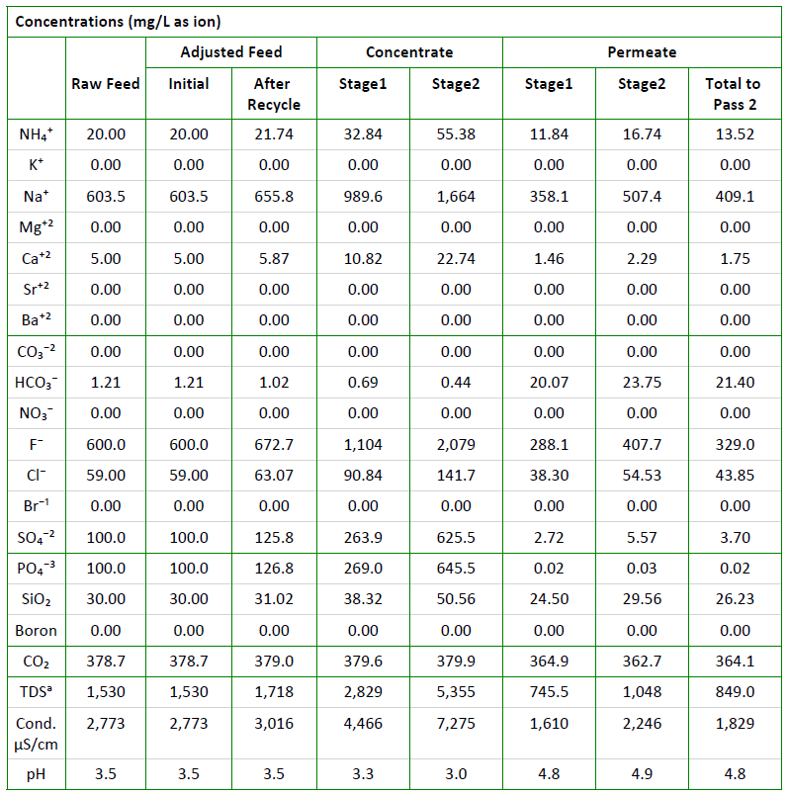
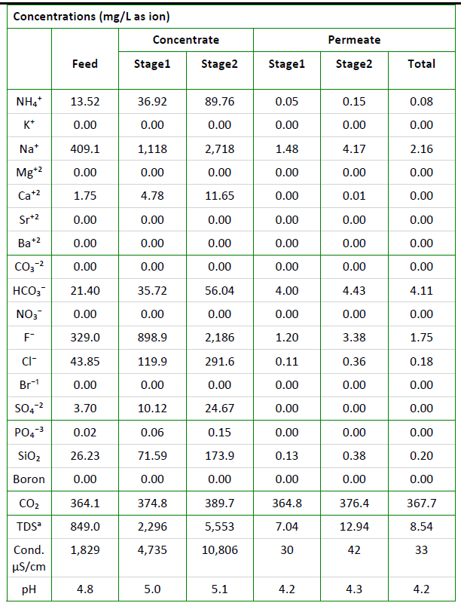
Option 6b – NF270+SWRO WITH 600 PPM of F
NF270
SWRO

Slide 49
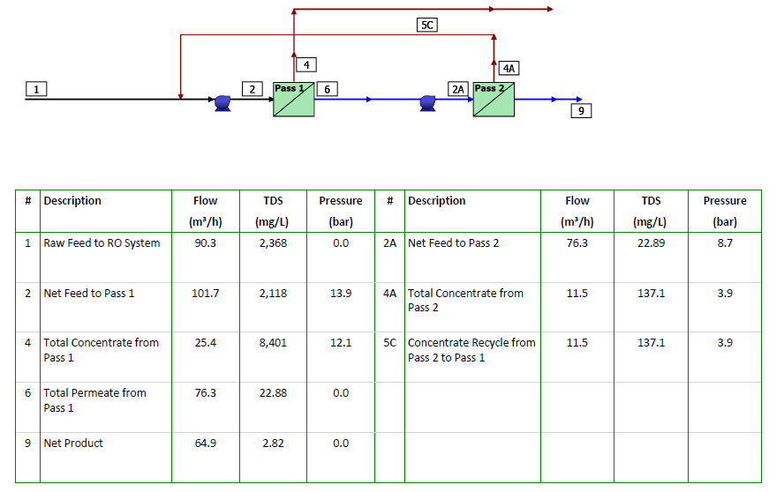
Option 7-HFW Effluent treatment – UF, RO

Slide 50
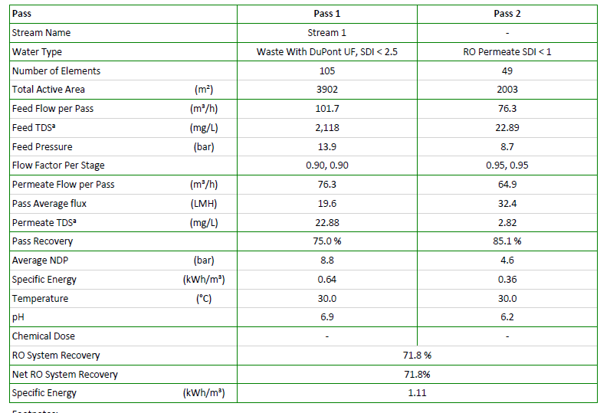
Option 7- HFW Effluent treatment ( UF & RO)

Slide 51


Option 7- HFW Effluent treatment (UF& RO)
Pass 1 – BWRO
Pass 2 - BWRO

Slide 52
Micron HFW Treatment -Next Steps and completion date
Sl.No. | Action Items | To be completed by | Remarks
1 | Perform projection to check the criticality of NF in this configuration If projection is good, will NF be a necessary unit operations here. What will be the benefits of incorporating NF in the design needs to be validated. | End/1st week of Dec | Will run few more simulations to validate the requirements
2 | The NaOH dosing for raising permeate Ph NaOH dosing requirement Final TDS | End/1st week of Dec | Will run few more simulations to validate the requirements
3 | Evaluate the effectiveness of Ca(OH)2 dosing by lab test Reaction rate with Ca(OH)2 Will increase of HRT help the completeness of reaction CaF2% in sludge to be validated for different water samples Settling velocity to be noted | End/1st week of Dec | Lab study
4 | As the projection data does not show on the TOC/IPA content in relevant streams, data to be generated based on some lab test or other projections | End/1st week of Dec | Lab study
5 | Na is coming into the streams due to ion balancing. Therefore, true presence of cations needs to be validated so that possible other contaminants issues can be identified. Clarified water characteristics RO permeate water characteristics | End/1st week of Dec | Simulations and lab study
6 | As neutralization with H2SO4 needs to take place for the clarified water, possibilities of any precipitation in the downstream to be verified | End/1st week of Dec | Simulations and lab study
7 | What will be the retrofits required if this system to be used for CMP waste-CMP WW Characteristics will be given later. | End/1st week of Dec | TBD
Notes:
200 micro siemens/cm
Solids – silica, abrasive,
No chemicals
ADD SLIDES for synthetic water

Slide 53


Action item 1 – Feasibility of SWRO +BWRO With 800 ppm of F

Slide 54

Action item 1 – Feasibility of SWRO +BWRO With 800 ppm of F

Slide 55


Action item 1 – Feasibility of SWRO +BWRO With 800 ppm of F
SWRO
BWRO

Slide 56

Action item 2: Permeate Ph adjustments
SWRO
pH adjustment

Slide 57


Action item 2: Option 6 – NF270 + SWRO With 800 ppm of F

Slide 58

Action item 2: Option 6 – NF270 + SWRO With 800 ppm of F

Slide 59


Action item 2: Option 6 – NF270+SWRO WITH 800 PPM of F
NF270
SWRO

Slide 60

Action item 2: Option 6 – polishing BWRO to meet NEWater
Notes:
Cooling water spec
Ammonia<5ppm
Fluoride<2 ppm

Slide 61


Action item 2: Option 6 – polishing BWRO to meet NEWater
Notes:
Cooling water spec
Ammonia<5ppm
Fluoride<2 ppm

Slide 62

Action item2: Option 6a–combined reject chemical precipitation

Slide 63

Action item 2: Option 6a–combined chemical precipitation –CaF2 sludge
>80% of CaF2 sludge

Slide 64

Action item 3: Preparation of Synthetic Combined NF RO Reject Solution (with pH adjustment)
Preferred chemicals | Required quantity for 1 Liter solution (gram)
NH4Cl | 0.210
NaCl | 0.064
CaCl2 | 0.049
HF | 2.986
H3PO4 | 0.367
SiH2O3 | 0.138
H2SO4 | 0.362
Elements | Desired concentration (ppm) | Calculated concentration based on added chemicals (ppm) | Concentration based on in-house measurement (ppm)
pH | 3.5 | - | 3.5
Conductivity | - | - | 6,375 µS/cm
TDS | - | - | 3,394
NH4 | 70.8 | 70.8 | 65.8
F | 2,835 | 2,835 | 2,928
SO4 | 355 | 355 | 345
PO4 | 356 | 356 | 366
Cl | 209 | 209 | 211
Na | 2,790 | 24.99 | 500
Ca | 17.7 | 17.7 | 11.1
Si | 49.5 | 49.5 | 47.6

Slide 65
Jar testing Procedure
To each testing jar, pour in 1L of wastewater sample
To each jar, dose in 7000/7500/8000 mg/L of Ca(OH)2 and rapid mix for 30s
Slow mix for 30 min, measure pH every 10 min
Dose 1mg/L for each of the SNF polymer (anionic) in each jar and further slower mix (30 rpm) for 30 min. Measure pH every 20 min
Stop mixing and leave the solids to settle over 60 min
Observe sludge settling and measure sludge height every 5 min (if applicable)
Measure turbidity of supernatant and collect the sludge
For the jar with the lowest supernatant turbidity reading, filter out the supernatant through 0.45 um filter and send for analysis and collect the sludge generated
For the sludge collected, filter out using 1.5 µm filter. Collect the sludge, dry sample for XRD analysis. Meanwhile, dissolve a pre-determined amount of collected sludge in acid and send for analysis

Slide 66



Action item 3: Jar testing of Synthetic Combined NF RO Reject (with pH adjustment) – Testing 1
Synthetic combined reject solution in different jars
Synthetic combined reject solution with added lime at different dosages (7000, 7500, 8000 ppm)
Solution with added flocculant (Flopam AN 934 SH). Precipitates clumped and settled after the addition of flocculant.

Slide 67
Action item 3: Jar testing of Synthetic Combined NF RO Reject (with pH adjustment) – Testing 1
Chemical precipitation with Ca(OH)2
Jar | Lime dosage (ppm) | pH
 |  | t = 15 min | t = 20 min | t = 30 min
1 | 7000 | 4.82 | 6.49 | 8.97
2 | 7500 | 9.98 | 11.08 | 11.46
3 | 8000 | 11.69 | 11.81 | 11.93
Coagulation and flocculation with 1 mg/L anionic polymer
Jar | Lime dosage (ppm) | pH |  |  | Polymer used
 |  | t = 10 min | t = 20 min | t = 30 min
1 | 7000 | 9.03 | 9.23 | 9.22 | Flopam AN 934 SH
2 | 7500 | 11.45 | 11.47 | 11.43 | Flopam AN 934 SH
3 | 8000 | 12.01 | 12.05 | 12.00 | Flopam AN 934 SH

Slide 68
Jar testing of Synthetic Combined NF RO Reject

Slide 69
Jar testing of Synthetic Combined NF RO Reject (with pH adjustment) – Testing 1
Jar | Polymer added | Lime dosage (ppm) | Supernatant turbidity (NTU)
1 | Flopam AN 934 SH | 7000 | 0.39
2 | Flopam AN 934 SH | 7500 | 0.33
3 | Flopam AN 934 SH | 8000 | 1.08
Elements | Concentration based on in-house measurement (ppm) | Supernatant quality for Jar 1 | Supernatant quality for Jar 2 | Supernatant quality for Jar 3
pH | 3.5 | 9.22 | 11.43 | 12
Conductivity | 6,375 µS/cm | 2,324 µS/cm | 2,338 µS/cm | 3,115 µS/cm
TDS | 3,394 | 1,177 | 1,185 | 1,603
NH4 | 65.8 | 67.4 | 55.7 | 51.6
F | 2,928 | 210 | 137 | 60.3
SO4 | 345 | 207 | 216 | 179
PO4 | 366 | <1 | <1 | <1
Cl | 211 | 192 | 194 | 194
Na | 500 | 493 | 459 | 478
Ca | 11.1 | 1.43 | 2.58 | 9.57
Si | 47.6 | 21.7 | 1.86 | 0.308

Slide 70



Action item 3: Jar testing of Synthetic Combined NF RO Reject (with pH adjustment) – Testing 2
Synthetic combined reject solution in different jars, with added different chemicals. Jar 1 from the left most to jar 4 in right most.
Starting of settling
End of settling

Slide 71
Action item 3: Jar testing of Synthetic Combined NF RO Reject (with pH adjustment )– Testing 2
Chemical precipitation with Ca(OH)2 (lime) and CaCl2
Jar | Chemical dosage | pH
 |  | t = 10 min | t = 20 min | t = 30 min
1 | 10,000 ppm lime | 12.52 | 12.59 | 12.62
2 | 12,000 ppm lime | 12.65 | 12.70 | 12.71
3 | 5,000 ppm lime + 5,000 ppm CaCl2 | 2.04 | 2.08 | 2.13
4 | 6,000 ppm lime + 6,000 ppm CaCl2 | 2.38 | 2.94 | 4.81
Coagulation and flocculation with 1 mg/L anionic polymer
Jar | Chemical dosage | pH |  |  | Polymer used
 |  | t = 2 min | t = 10 min | t = 30 min
1 | 10,000 ppm lime | 12.58 | 12.54 | 12.56 | Flopam AN 934 SH
2 | 12,000 ppm lime | 12.67 | 12.72 | 12.65 | Flopam AN 934 SH
3 | 5,000 ppm lime + 5,000 ppm CaCl2 | 2.13 | 2.13 | 2.09 | Flopam AN 934 SH
4 | 6,000 ppm lime + 6,000 ppm CaCl2 | 6.21 | 6.29 | 6.48 | Flopam AN 934 SH

Slide 72
Action item 3: Jar testing of Synthetic Combined NF RO Reject (with pH adjustment) – Testing 2
Jar | Polymer added | Chemicals dosage | Supernatant turbidity (NTU)
1 | Flopam AN 934 SH | 10,000 ppm lime | 20.8
2 | Flopam AN 934 SH | 12,000 ppm lime | 74.2
3 | Flopam AN 934 SH | 5,000 ppm lime + 5,000 ppm CaCl2 | 430
4 | Flopam AN 934 SH | 6,000 ppm lime + 6,000 ppm CaCl2 | 496
Elements | Concentration based on in-house measurement (ppm) | Supernatant quality for Jar 1 | Supernatant quality for Jar 2 | Supernatant quality for Jar 3 | Supernatant quality for Jar 4
pH | 3.5 | 12.56 | 12.65 | 2.09 | 6.48
Conductivity | 6,375 µS/cm | 8,233 µS/cm | 10.64 mS/cm | 11.76 mS/cm | 10.43 mS/cm
TDS | 3,394 | 4,460 | 5,867 | 6,526 | 5,745
NH4 | 65.8 | 57 | 59.4 | 68.4 | 72.6
F | 2,928 | 8.21 | 5.61 | 187 | 610
SO4 | 345 | 72.4 | 50.6 | 32 | 96.3
PO4 | 366 | <1 | <1 | 241 | 83
Cl | 211 | 191 | 164 | 2,939 | 3,548
Na | 500 | 353 | 343 | 365 | 402
Ca | 11.1 | 389 | 622 | 1,077 | 2,139
Si | 47.6 | <0.1 | <0.1 | 65.2 | 66.7

Slide 73
Action item 3: Jar testing of Synthetic Combined NF RO Reject (with pH adjustment) – Testing 3
Jar | Polymer added | Chemical's dosage | Supernatant turbidity (NTU)
1 | Flopam AN 934 SH | 8000 ppm lime + 4000 ppm CaCl2 | 56.9
2 | Flopam AN 934 SH | 8000 ppm lime + 10000 ppm CaCl2 | 226
3 | Flopam AN 934 SH | 8000 ppm lime + 6000 ppm CaCl2 | 138
4 | Flopam AN 934 SH | 8000 ppm lime + 8000 ppm CaCl2 | 162
5 | Flopam AN 934 SH | 6000 ppm lime + 4000 ppm CaCl2 | 22
Elements | Concentration based on in-house measurement (ppm) | Supernatant quality for Jar 1 | Supernatant quality for Jar 2 | Supernatant quality for Jar 3 | Supernatant quality for Jar 4 | Supernatant quality for Jar 5
pH | 3.5 | 11.96 | 11.91 | 12.03 | 11.91 | 9.8
Conductivity | 6,375 µS/cm | 8889 µS/cm | 17.23 mS/cm | 11.93 mS/cm | 14.4 mS/cm | 7756 µS/cm
TDS | 3,394 | 4844 | 9824 | 6624 | 8108 | 4180
F | 2,928 | 9.15 | 13 | 29.1 | 14 | 14.2
SO4 | 345 | 116 | 117 | 114 | 114 | 106
PO4 | 366 | <1 | <1 | 3.14 | <1 | <1
Cl | 211 | TBC | TBC | TBC | TBC | 2376
Na | 500 | 440 | 496 | 440 | 434 | 429
Ca | 11.1 | 1098 | 2858 | 1738 | 2263 | 920
Si | 47.6 | 0.149 | 0.342 | 0.863 | 0.356 | 10.5

Slide 74

Action item 3 : XRD analysis of CaF2 sludge
Synthetic combined reject solution with added lime at 7500 PPM
Notes:
Area

Slide 75


Action item 4: Preparation of Synthetic HFW+NH4F Solution (with pH adjustment)
Preferred chemicals | Required quantity for 1 Liter solution (gram)
NH4Cl | 0.059
NaCl | 0.013
CaCl2 | 0.014
HF | 0.843
H3PO4 | 0.206
SiH2O3 | 0.039
H2SO4 | 0.102
Elements | Desired concentration (ppm) | Calculated concentration based on added chemicals (ppm) | Concentration based on in-house measurement (ppm)
pH | 3.5 | - | 3.5
Conductivity | - | - | 2,481 µS/cm
TDS | - | - | 1,263
NH4 | 20 | 20 | 19.2
F | 800 | 800 | 789
SO4 | 100 | 100 | 98
PO4 | 200 | 200 | 205
Cl | 50 | 55.86 | 62.9
Na | 5 | 5 | 339
Ca | 5 | 5 | 4.05
Si | 14.02 | 14.02 | 16.2

Slide 76


Action item 4: Anti-scalant compatibility test - NF filtration of HFW+NH4F with IPA (with pH adjustment)
Initial solution pH: 3.3, pH adjusted to 3.5
Anti-scalant | pH | Solution appearance
AS1 | 3.0 | Clear
AS2 | 7.19 | Clear
AS3 | 3.7 | Clear
AS4 | 3.58 | Clear
AS4 was selected for the NF filtration experiment because its addition into the feed solution didn’t alter the solution pH much.

Slide 77
Action item 4: Result of NF filtration of HFW+NH4F with IPA (with pH adjustment)
Elements | Concentration for synthetic feed (ppm) | Concentrated feed (ppm) | Permeate (ppm)
pH | 3.5 | 5.04 | 3.29
Conductivity | 3,357 µS/cm | 9,022 µS/cm | 708.6 µS/cm
TDS | 1,134 | 4,921 | 344.4
NH4 | 19.7 | 50.1 | 12.2
F | 819 | 1,555 | 144
SO4 | 100 | 389 | 3.83
PO4 | 214 | 637 | 1.55
Cl | 54.3 | 178 | 21
Na | 721 | 2082 | 86
Ca | 1.49 | <0.1 | <0.1
Si | 12.7 | 73.9 | 51.9
COD | 2,450 | 3935 | 1580
TOC | 473 | 870 | 382
IPA | TBC | TBC | TBC

Slide 78
Action item 5: Preparation of Synthetic Combined NF RO Reject Solution (without pH adjustment)
Preferred chemicals | Required quantity for 1 Liter solution (gram)
NH4Cl | 0.209
NaCl | 0.011
CaCl2 | 0.049
HF | 2.242
H3PO4 | 0.367
SiH2O3 | 0.128
H2SO4 | 0.362
Elements | Desired concentration (ppm) | Calculated concentration based on added chemicals (ppm) | Concentration based on in-house measurement (ppm)
pH | 1.9 | - | 3
Conductivity | - | - | 7745 µS/cm
TDS | - | - | 4175
NH4 | 70.6 | 70.6 | TBC
F | 2129 | 2129 | 2304
SO4 | 355 | 355 | TBC
PO4 | 356 | 356 | 389
Cl | 177 | 177 | TBC
Na | 17.6 | 4.49 | 7.74
Ca | 17.7 | 17.7 | 7.94
Si | 46.2 | 46.2 | 41.2

Slide 79
Action item 5: Jar testing of Synthetic Combined NF RO Reject (without pH adjustment)– Testing 4
Jar | Polymer added | Chemical's dosage | Supernatant turbidity (NTU)
1 | Flopam AN 934 SH | 6000 ppm lime + 500 ppm CaCl2 | 9.98
2 | Flopam AN 934 SH | 6000 lime + 4000 ppm CaCl2 | 20.4
Elements | Concentration based on in-house measurement (ppm) | Supernatant quality for Jar 1 | Supernatant quality for Jar 2
pH | 3 | 9.68 | 9.29
Conductivity | 7745 | 1941 µS/cm | 7256 µS/cm
TDS | 4175 | 974.7 | 3889
F | 2304 | 22 | 7.51
SO4 | TBC | 150 | 137
PO4 | 389 | <1 | <1
Na | 7.74 | 8.2 | 25.4
Ca | 7.94 | 295 | 1290
Si | 41.2 | 14.9 | 5.66

Slide 80
Action item 5: Preparation of Synthetic HFW+NH4F with IPA (without pH adjustment)
Preferred chemicals | Required quantity for 1 Liter solution (gram)
NH4Cl | 0.059
NaCl | 0.013
CaCl2 | 0.014
HF | 0.843
H3PO4 | 0.206
SiH2O3 | 0.039
H2SO4 | 0.102
IPA | 1
Elements | Desired concentration (ppm) | Calculated concentration based on added chemicals (ppm) | Concentration based on in-house measurement (ppm)
pH | - | - | 2.92
Conductivity | - | - | 3371 µS/cm
TDS | - | - | 1741
NH4 | 20 | 20 | TBC
F | 800 | 800 | 802
SO4 | 100 | 100 | TBC
PO4 | 200 | 200 | 161
Cl | 50 | 55.86 | TBC
Na | 5 | 5 | 10.1
Ca | 5 | 5 | 4.6
Si | 14.02 | 14.02 | 9.15
COD | - | - | 2523
TOC | - | - | 588
IPA | 1,000 | 1,000 | TBC

Slide 81
Action item 5: Results of NF filtration of HFW+NH4F with IPA (without pH adjustment)
Elements | Concentration for synthetic feed (ppm) | NF concentrated feed (ppm) | NF Permeate (ppm)
pH | 2.92 | 2.08 | 2.26
Conductivity | 3371 µS/cm | 4821 µS/cm | 3071 µS/cm
TDS | 1741 | 2535 | 1580
F | 802 | 1328 | 456
SO4 | TBC | 201 | 88.9
PO4 | 161 | 203 | 150
Cl | TBC | 152 | 147
Na | 10.1 | 30.9 | 4.72
Ca | 4.6 | 21.5 | 0.105
Si | 9.15 | 41.5 | 4.19
COD | 2523 | 2970 | 2013
TOC | 588 | 691 | 484

Slide 82


Action item6: supernatant pH adjustment using H2SO4

Slide 83


Additional Action item: Feasibility of NF270 + SWRO With 800 ppm of F, 500 ppm of PO4 and 300 ppm of Sulphates

Slide 84

Additional Action item: Feasibility of NF270 + SWRO With 800 ppm of F, 500 ppm of PO4 and 300 ppm of Sulphates

Slide 85


Additional Action item: Feasibility of NF270 + SWRO With 800 ppm of F, 500 ppm of PO4 and 300 ppm of Sulphates
NF 270
SWRO

Slide 86


Additional Action item: Combined reject chemical precipitation

Slide 87
Conclusions
Following conclusions are made based on several RO/NF projections, bench scale testing and PHREEQC models
UF, NF and SWRO will be sufficient for generating required water quality for cooling tower and local scrubbers. Recovery ratio between 55-60%.
Lower pH will be helpful to get higher membrane rejections. No scaling issues with lower pH. Conventional membranes will be used for pH between 2 to 12
Mixed/NF +SWRO reject for removal of Fluoride (by coagulation, flocculation, clarification, sedimentation, filter press) looks a suitable configuration.
Lime and CaCl2 combination or higher amount of lime will be enough for the removal of fluoride to meet the discharge water quality.
Sludge will contain more than 80% of CaF2. if in case phosphates are higher, then sludge quality will differ. XRD results shows the major peak is CaF2.
NF will be having tolerance to the organics. Experiments are on going to validate the % IPA rejections.
Optimization of chemical dosage/conditions can be done during detailed engineering design

Slide 88
Back up

